Slide 1
Technical Kickoff / Requirements Review
Singapore Basic Wings Course Immersive Training Device (ITD) Contract Variation Agreement (CVA)
6th December 2023
Prepared by: Lockheed Martin Corporation Rotary and Mission Systems 100 Global Innovation Circle Orlando, FL 32825

Slide 2
Agenda
Team Overview
Program Overview
TKO/RR Overview & Objectives
Schedule
Deliverables
System Overview
Highlighted Topics
Capture of Action Items
Review of Exit Criteria / Recommendation

Slide 3
BWC program team
Lockheed Martin
Program Manager, ITD CVA | Kyle Tauzer
Program Manager, BWC | Russell Page
Finance | Alexander Vintilla
Contracts | Jonathan Antoniewski
Subcontracts | Casey Leroy
EPM | Bob Lyle
Systems Engineering | Michael Kerkes
Software Engineering | Jeremiah Helwig
Hardware Engineering | Matthew Listro
Black6
CEO | Rikky Burkett
Head of Engineering | Alex Reynolds
Chief Technology Officer | Jim Alary
Compliance Manager | Rob Legat

Slide 4
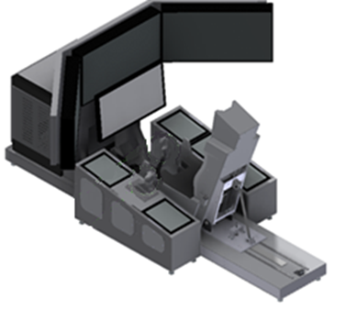

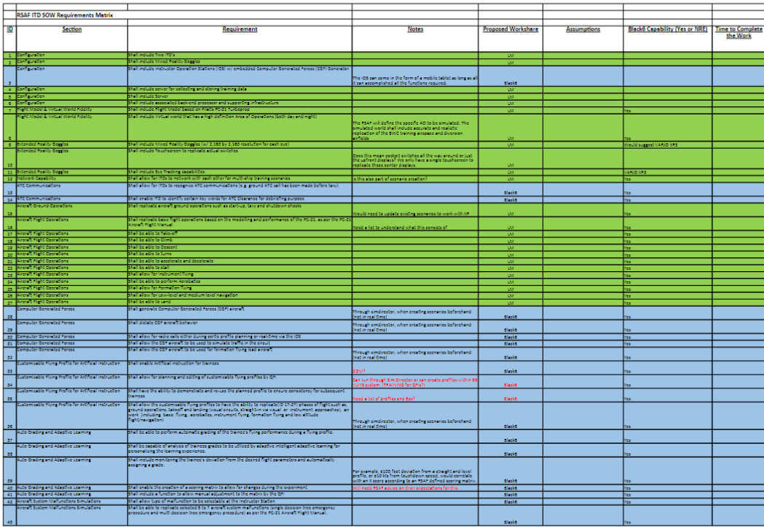


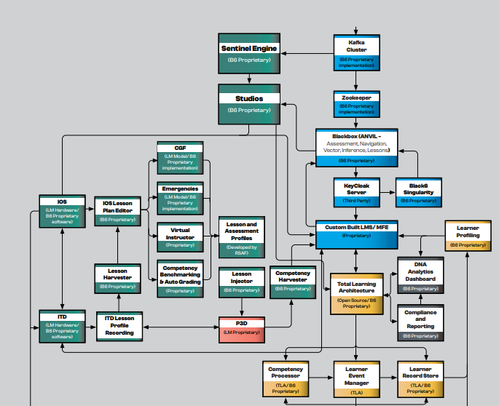
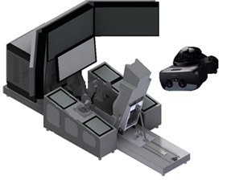
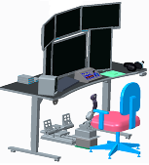
Program Overview
Pearce, AUS
Orlando, FL, USA
TKO/RR
FTDs not modified
Orlando Lab Assets Available
RVTM Presented
EDR#1
Orlando Lab Assets Available
Partial Parts Deliveries
FTDs not modified
BWC TAA
Design Presented
EDR#2
RSAF Participates in Testing
LM RMS makes shipping go/no-go decision
FTDs still in original condition
Orlando Lab FTD in Deliverable Config
TRR/OSAT
FTDs + IOS’s in Final Configuration
RSAF Final Acceptance
Orlando Lab Returned to FTD Config

Slide 5
Tko/RR Overview & Objectives
From CN0601010725 Attachment 1 Annex SS
Technical Kick-off (TKO) / Requirements Review (RR)
a. The Contractor shall host a TKO / RR meeting within 30 days upon signing of the Variation Agreement by both Parties.
b. The TKO / RR shall, as a minimum, consist of a review of the following items:
Draft CRD
Draft RVTM
Draft schedule of project milestones, Customer reviews and acceptance tests
Exit Criteria
TKO/RR Conducted
Draft CRD, RVTM, and schedule of project milestones presented
Meeting action items documented
Certificate of Completion signed by the Contractor and the Authority documenting completion of exit criteria
All Entry Criteria met to proceed with TKO/RR Event

Slide 6
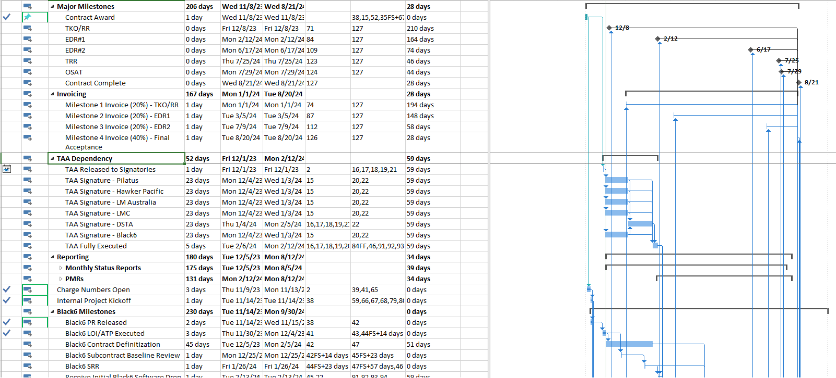
Schedule of Milestones, Customer Reviews, and Acceptance Tests
Full IMS Drafted and Delivered for review prior to meeting. Summary level on next page

Slide 7
Schedule of Milestones, Customer Reviews, and Acceptance Tests
June
July
Aug
Sept
Oct
Nov
Dec
Jan
Feb
Mar
Apr
May
June
July
Aug
ITC Activities
-2
-1
1
2
TAA Modification Submittal
U.S. State Dept Approval
Signatory Signatures Complete
TAA Final
Material/ Procurement
-3
-2
-1
2
5
Long Lead Material FEA Approval
Long Lead Material Engineering Released
Long Lead Material On Order
Full BOM on Order
All Material Received
LM Development
0
1
2
3
5
6
7
8
9
Contract Award
TKO/RR
Software Upgrade
Capital HW Mods
HSI + Tuning Event
EDR1
EDR2
TRR/OSAT
Completion
Black6 Development
0
1
2
3
5
8
9
LOI/ATP
RR
EDR
Software Drop 1
Integration Complete
OSAT
Completion

Slide 8
Schedule Risk Items
TAA Signature
Long Lead Item Hardware Delivery
Completion of EDR1 event (scheduled Jan 2024) is dependent on TAA Signature. Currently in final reviews with DSTA. Primarily affects ability to share design details and exchange software with Black6.
Mitigations to Date: TAA activities started pre-contract award. TAA reviewed and found in-scope for current BWC signatories.
Proposed mitigation: Work to accelerate reviews and signatures to hold schedule. In limited capacity begin siloed development prior to EDR1 (adds technical execution/integration risk)
Cockpit controls hardware may extend outside current program delivery schedule. Additionally, end user desires functionality ahead of contracted lead time (April)
Mitigations to Date: Long Lead items ordered pre-contract award. Design and fabrication in process.
Proposed Mitigation: Active engagement with controls vendor to reduce lead time (currently meeting some success here). Consider viability of early interim delivery of uplifted software prior to receipt of new controls in March/April timeframe, if desired.

Slide 9
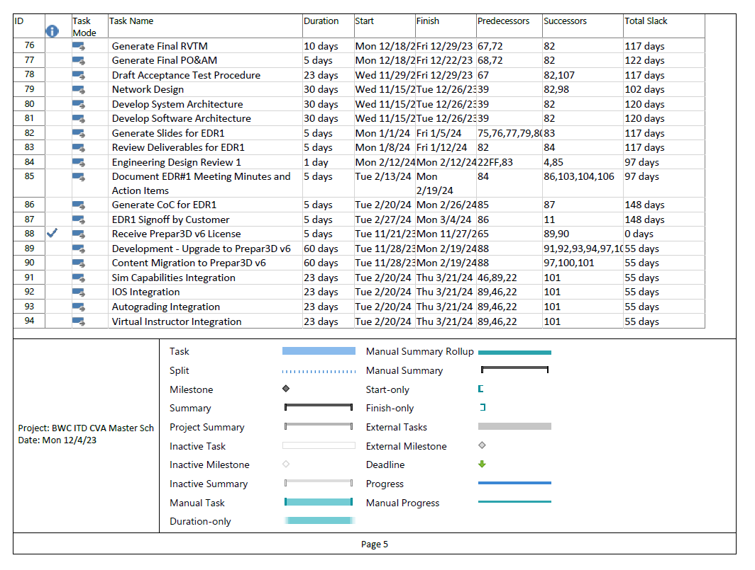
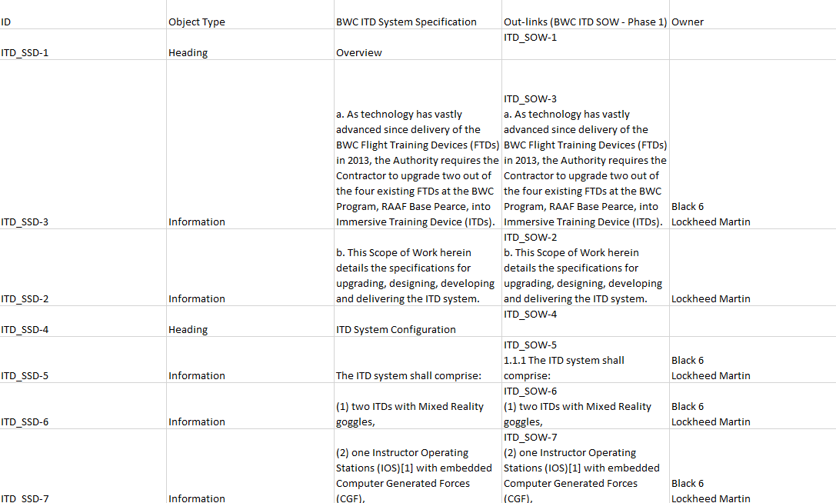
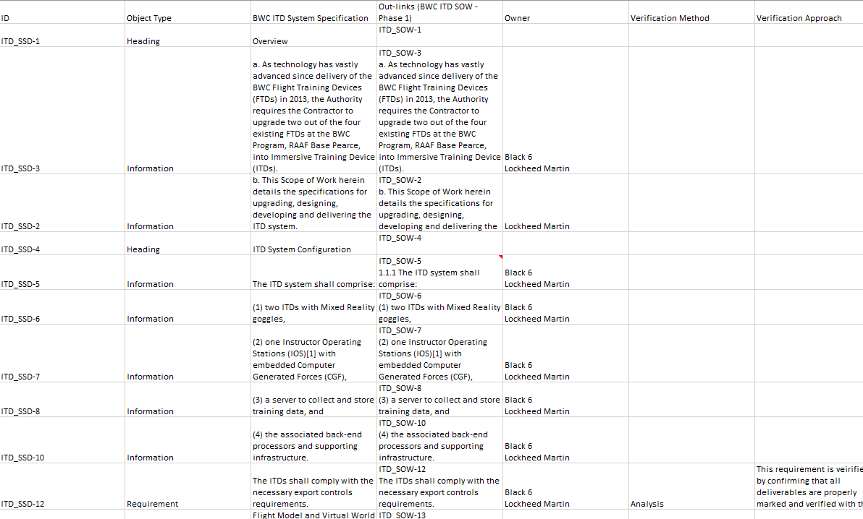
Deliverables
TKO/RR Deliverables | Summary | Status
Schedule of Project Milestones, customer reviews, and acceptance tests. | Interconnected/linked schedule tracking all tasks, durations, dependencies, and deliverables required for completion of the program. | Draft Delivered 12/1/23 – LM in possession of comments/clarifications
Customer Requirement Document (CRD) | Compiled export of requirements derived from customer supplied SOW | Draft Delivered 12/1/23
Requirements Verification Traceability Matrix (RVTM) | Compiled export of Requirements Verification Method, Requirements Verification Approach, Clarifications, and the associated requirements | Draft Delivered 12/1/23 – LM in possession of comments/clarifications

Slide 10
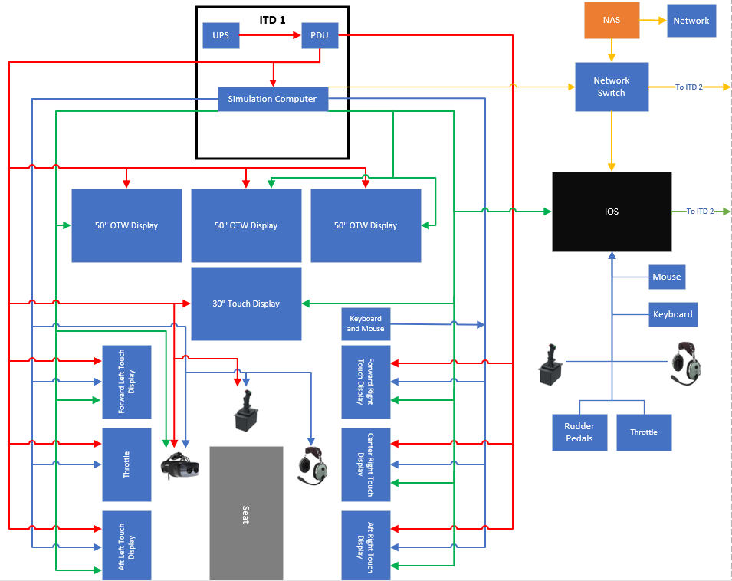
System Overview
AC Power
Ethernet
Video Cable
USB Cable
KEY
Not Pictured:
Facility Power
ITD #2

Slide 11
Highlighted Topics/QA
ID | Requirement Text | Clarification Question
ITD_SSD-139 | The simulated world shall include accurate and realistic replication of the BWC training airspace and diversion airfields. | RSAF: How will we get the assurance that the simulated world (i.e. identified training space and airfields) are accurate?
ITD_SSD-64 | The ITD visual system shall provide sufficient definition to display the simulated environment and aircraft cockpit instruments. | It was requested to use both LM SME and RSAF SME for verification. This requirement should be bounded further to facilitate the approval process
ITD_SSD-203 | The ITDs shall have a virtual instructor to facilitate trainees’ Self-Directed Learning (SDL). | RSAF: What are the SDL features?
ITD_SSD-65 | The IOS shall provide a Field Of View (FOV) of what the trainee is seeing in the goggles. | RSAF: Is this presented on a standalone monitor?
ITD_SSD-214 | The visual effects required shall include minimally the following: a. Different lighting conditions that correspond to the different times of the day (day and night) b. Clouds and haze c. Precipitation and lightning d. Sea state for depth of perception e. Wind (e.g. windsock deflection) f. International Civil Aviation Organisation (ICAO) standard airfield lighting g. Cultural lighting | RSAF: Draft supplement proposed verified as certification as these are standard capabilities of Prepar3D, however feedback indicates a desire for demonstration
ITD_SSD-81 | The IOS shall be used to perform the following functions for the ITDs independently during con-current training session: The IOS shall be used to perform real-time monitoring of the trainee’s flight progress, control inputs (aircraft handling and avionics inputs/selection) and psychophysiology data (eye tracking). The IOS shall be used to perform placing, removing and controlling CGFs. | RSAF: Does each ITD have a separate IOS screen? How do we display all the screens concurrently for both ITD? RSAF: Both ITDs are in the same environment or separate environment?

Slide 12
Highlighted Topics/QA
ID | Requirement Text | Clarification Question
ITD_SSD-92 | The IOS shall be equipped with a generic control stick that mirrors the functionality of the cockpit controls and be capable of operating either ITD from the IOS. | RSAF: Mimiced motion is replicated at both ITDs? Is there a selection at IOS to select which ITD (i.e. only 1 ITD) will replicate the control stick motion?
ITD_SSD-128 | The flight simulation shall be provided with a software backup facility such that the system can be restored to the last working configuration in the event of software corruption. | RSAF: Why is it split between flight simulation and IOS?
ITD_SSD-210 | The ITDs shall have a Training Profile and Records System to facilitate trainees’ SDL. | LM: Is the Records System just previously recorded profiles? What features should the Record's System have?
ITD_SSD-211 | The system shall maintain individual trainee profiles and performance tracking. | LM: Is the expectation that a user would have an "account" with multiple flight profiles assigned? Or would there be flight profiles each with an individual trainee's performance?
ITD_SSD-77 | The IOS shall be designed to display concurrently, but not limited to, the trainee’s instrument displays and control inputs, current position, menu to select emergencies, and psychophysiological sensor output, at a comfortable viewing distance. | LM: Are there other screens that are wanted to be displayed simultaneously?
ITD_SSD-87 | The IOS shall be used to conduct debriefs | LM: Is there any other feedback on how the debrief capability is expected to look or function? Any capabilities outside of record, playback, and rewind?
ITD_SSD-101 | This shall be presented in both a dashboard format and in the form of a grade sheet. | LM: Is there any feedback on the look of the dashboard or the contents of the grade sheet?
ITD_SSD-95 | The data shall be in such a format that would facilitate seamless transfer if required in the future. | LM: Further detail required for what a "seamless transfer" is expected to be.
ITD_SSD-134 ITD_SSD-136 ITD_SSD-137 | a. Service Life. The ITDs shall have a service life of at least four years. b. Operating Period. The ITDs shall be operable for at least 12 hours/day and 3,500 hours per year. Each ITD shall be able to support up to 14 hours of continuous operation. | RSAF: To discuss how will this be verified

Slide 13
Action Items
Action # | Action | Responsibility | Due
1 | Update RVTM Per Comments Received from DSTA 12/5 | Kerkes (LM) | Final Due at EDR1
2 | Update IMS per comments received from DSTA 12/5 | Tauzer (LM) | Final Due at EDR1
3 | Complete review of TAA and obtain signatures | Joint | Final signed due before EDR1 can be scheduled
4 | Draft and Circulate TKO/RR Meeting Minutes | Tauzer (LM) | 12/13/2023
5 | Prepare C of C for TKO/RR Signature | Tauzer (LM) | 12/22/2023
6 | Schedule EDR1 for late January, Early February | Tauzer (LM) | 12/22/2023
7 | Determine whether a UPS is required for the IOS station | Listro (LM) | EDR1
8 | Following definition of AOs at EDR1, review Prepar3D stock database with DSTA | Tauzer | Following EDR1
9 | Provide a list of features available for customization of in-flight prompts and autograding profile customization, debrief features, and gradesheet content | Burkett (Black6) | 12/22/2023
10 | Send initial IOS screen real estate allocation to Jett for agreement prior to EDR1 | Kerkes (LM) | EDR1
11 | Provide clarification on requirement for seamless data transfer and whether that just means xAPI compliant | Kenny (DSTA) | EDR1

Slide 14

TKO/RR Exit Criteria
From CN0601010725 Attachment 1 Annex SS
Technical Kick-off (TKO) / Requirements Review (RR)
a. The Contractor shall host a TKO / RR meeting within 30 days upon signing of the Variation Agreement by both Parties.
b. The TKO / RR shall, as a minimum, consist of a review of the following items:
Draft CRD
Draft RVTM
Draft schedule of project milestones, Customer reviews and acceptance tests
Exit Criteria
TKO/RR Conducted
Draft CRD, RVTM, and schedule of project milestones presented
Meeting action items documented
Certificate of Completion signed by the Contractor and the Authority documenting completion of exit criteria
LM Recommends exit of TKO/RR Event, and preparation of C of C for signature

